Slide 1
Nelson Mandela
From Wikipedia, the free encyclopedia
https://en.wikipedia.org/wiki/Nelson%20Mandela
Licensed under CC BY-SA 3.0:
https://en.wikipedia.org/wiki/Wikipedia:Text_of_Creative_Commons_Attribution-ShareAlike_3.0_Unported_License

Slide 2
Nelson Mandela
Mandela and de Klerk led efforts to negotiate an end to apartheid, which resulted in the 1994 multiracial general election in which Mandela led the ANC to victory and became president.
Mandela became an elder statesman and focused on combating poverty and HIV/AIDS through the charitable Nelson Mandela Foundation.
Mandela was a controversial figure for much of his life.

Slide 3
Childhood: 1918–1934
One of Ngubengcuka's sons, named Mandela, was Nelson's grandfather and the source of his surname.
Baptised a Methodist, Mandela was given the English forename of "Nelson" by his teacher.
When Mandela was about nine, his father came to stay at Qunu, where he died of an undiagnosed ailment which Mandela believed to be lung disease.

Slide 4
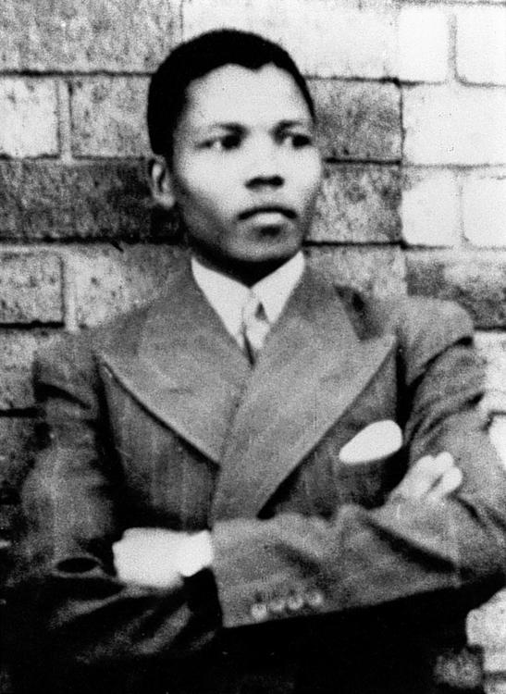
Photograph of Mandela, taken in Umtata in 1937

Slide 5
Clarkebury, Healdtown, and Fort Hare: 1934–1940
Mandela spent much of his spare time at Healdtown as a long-distance runner and boxer, and in his second year he became a prefect.
Although he had friends connected to the African National Congress (ANC) who wanted South Africa to be independent of the British Empire, Mandela avoided any involvement with the anti-imperialist movement, and became a vocal supporter of the British war effort when the Second World War broke out.

Slide 6
Arriving in Johannesburg: 1941–1943
He stayed with a cousin in George Goch Township, who introduced Mandela to realtor and ANC activist Walter Sisulu.
To continue his higher education, Mandela signed up to a University of South Africa correspondence course, working on his bachelor's degree at night.
Mandela and Justice arrived a day late for the funeral.

Slide 7
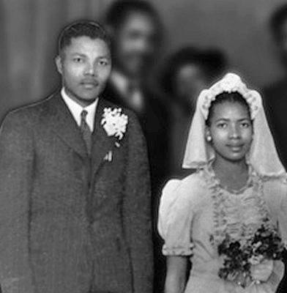
Mandela and Evelyn in July 1944, at Walter and Albertina Sisulu's wedding party in the Bantu Men's Social Centre.

Slide 8
Law studies and the ANC Youth League: 1943–1949
Mandela began studying law at the University of the Witwatersrand, where he was the only black African student and faced racism.
Mandela enjoyed home life, welcoming his mother and his sister, Leabie, to stay with him.
Mandela later related that he and his colleagues had "guided the ANC to a more radical and revolutionary path."

Slide 9
Defiance Campaign and Transvaal ANC Presidency: 1950–1954
These events established Mandela as one of the best-known black political figures in South Africa.
Although Africanists opposed his candidacy, Mandela was elected regional president in October.
In August 1953, Mandela and Tambo opened their own law firm, Mandela and Tambo, operating in downtown Johannesburg.

Slide 10
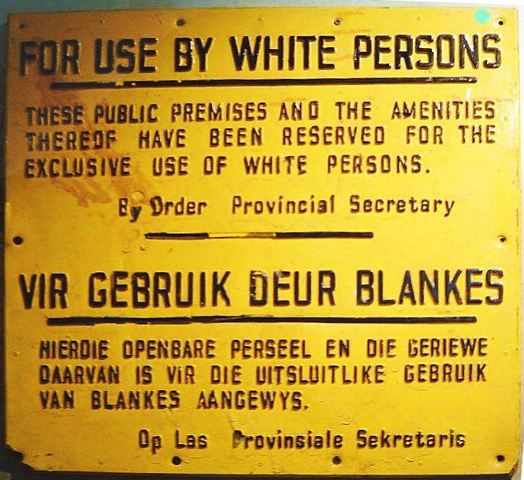
An apartheid sign; apartheid legislation impacted all areas of life

Slide 11
Congress of the People and the Treason Trial: 1955–1961
The tenets of the Freedom Charter remained important for Mandela, and in 1956 he described it as "an inspiration to the people of South Africa".
Mandela's marriage broke down and Evelyn left him, taking their children to live with her brother.
In December 1956, Mandela was arrested alongside most of the ANC national executive, and accused of "high treason" against the state.

Slide 12
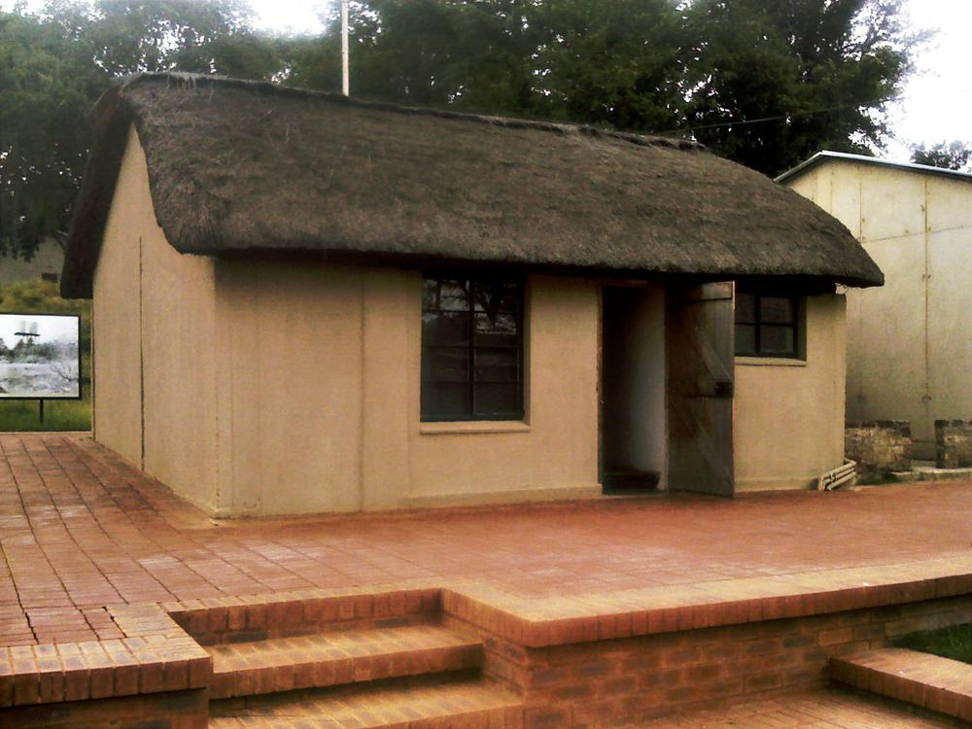
Thatched room at Liliesleaf Farm, where Mandela hid

Slide 13
MK, the SACP, and African tour: 1961–62
This was confirmed by both the SACP and the ANC after Mandela's death.
Leaving South Africa in secret via Bechuanaland, on his way Mandela visited Tanganyika and met with its president, Julius Nyerere.
Arriving in Ethiopia, Mandela met with Emperor Haile Selassie I, and gave his speech after Selassie's at the conference.

Slide 14
Arrest and Rivonia trial: 1962–1964
On 5 August 1962, police captured Mandela along with fellow activist Cecil Williams near Howick.
Many MK members suspected that the authorities had been tipped off with regard to Mandela's whereabouts, although Mandela himself gave these ideas little credence.
Jailed in Johannesburg's Marshall Square prison, Mandela was charged with inciting workers' strikes and leaving the country without permission.

Slide 15
Robben Island: 1964–1982
Various official visitors met with Mandela, most significantly the liberal parliamentary representative Helen Suzman of the Progressive Party, who championed Mandela's cause outside of prison.
In 1969, an escape plan for Mandela was developed by Gordon Bruce, but it was abandoned after the conspiracy was infiltrated by an agent of the South African Bureau of State Security (BOSS), who hoped to see Mandela shot during the escape.
In March 1980, the slogan "Free Mandela!"

Slide 16
Pollsmoor Prison: 1982–1988
Conditions at Pollsmoor were better than at Robben Island, although Mandela missed the camaraderie and scenery of the island.
Mandela spurned the offer, releasing a statement through his daughter Zindzi stating, "What freedom am I being offered while the organisation of the people [ANC] remains banned?
Mandela rejected these conditions, insisting that the ANC would end its armed activities only when the government renounced violence.

Slide 17
Victor Verster Prison and release: 1988–1990
In a surprise move, Botha invited Mandela to a meeting over tea in July 1989, an invitation Mandela considered genial.
Although some were deeply opposed to his plans, de Klerk met with Mandela in December to discuss the situation, a meeting both men considered friendly, before legalising all formerly banned political parties in February 1990 and announcing Mandela's unconditional release.
Shortly thereafter, for the first time in 20 years, photographs of Mandela were allowed to be published in South Africa.

Slide 18
Early negotiations: 1990–91
Mandela proceeded on an African tour, meeting supporters and politicians in Zambia, Zimbabwe, Namibia, Libya and Algeria, and continuing to Sweden, where he was reunited with Tambo, and London, where he appeared at the Nelson Mandela: An International Tribute for a Free South Africa concert at Wembley Stadium in Wembley Park.
On 13 April 1992, Mandela publicly announced his separation from Winnie.
Mandela met with Inkatha leader Buthelezi, but the ANC prevented further negotiations on the issue.

Slide 19
CODESA talks: 1991–92
Following the murder of ANC activist Chris Hani, Mandela made a publicised speech to calm rioting, soon after appearing at a mass funeral in Soweto for Tambo, who had died of a stroke.
In July 1993, both Mandela and de Klerk visited the US, independently meeting President Bill Clinton and each receiving the Liberty Medal.
Soon after, Mandela and de Klerk were jointly awarded the Nobel Peace Prize in Norway.

Slide 20
General election: 1994
With the exception of the Weekly Mail and the New Nation, South Africa's press opposed Mandela's election, fearing continued ethnic strife, instead supporting the National or Democratic Party.
As leaders of the two major parties, de Klerk and Mandela appeared on a televised debate; although de Klerk was widely considered the better speaker at the event, Mandela's offer to shake his hand surprised him, leading some commentators to deem it a victory for Mandela.

Slide 21
Presidency of South Africa: 1994–1999
The newly elected National Assembly's first act was to formally elect Mandela as South Africa's first black chief executive.
Despite his opulent surroundings, Mandela lived simply, donating a third of his R 552,000 annual income to the Nelson Mandela Children's Fund, which he had founded in 1995.
She turned down Mandela's first marriage proposal, wanting to retain some independence and dividing her time between Mozambique and Johannesburg.

Slide 22
National reconciliation
Mandela's relationship with de Klerk was strained; Mandela thought that de Klerk was intentionally provocative, and de Klerk felt that he was being intentionally humiliated by the president.
Mandela wore a Springbok shirt at the final against New Zealand, and after the Springboks won the match, Mandela presented the trophy to captain Francois Pienaar, an Afrikaner.

Slide 23
Domestic programmes
Mandela's administration inherited a country with a huge disparity in wealth and services between white and black communities.
Under Mandela's administration, tourism was increasingly promoted, becoming a major sector of the South African economy.
Mandela's administration was also perceived as having failed to deal with the problem of corruption.
This exodus resulted in a brain drain, and Mandela criticised those who left.

Slide 24
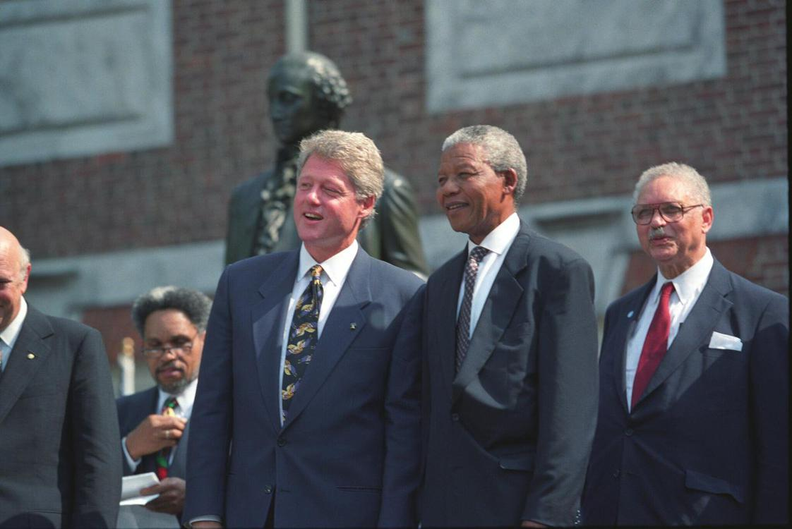
Mandela with US President Bill Clinton. Despite publicly criticising him on several occasions, Mandela liked Clinton, and personally supported him during his impeachment proceedings.

Slide 25
Foreign affairs
Following the South African example, Mandela encouraged other nations to resolve conflicts through diplomacy and reconciliation.
Mandela echoed Mbeki's calls for an "African Renaissance", and was greatly concerned with issues on the continent.
The action was not authorised by Mandela himself, who was out of the country at the time, but by Buthelezi, who was serving as acting president during Mandela's absence.

Slide 26
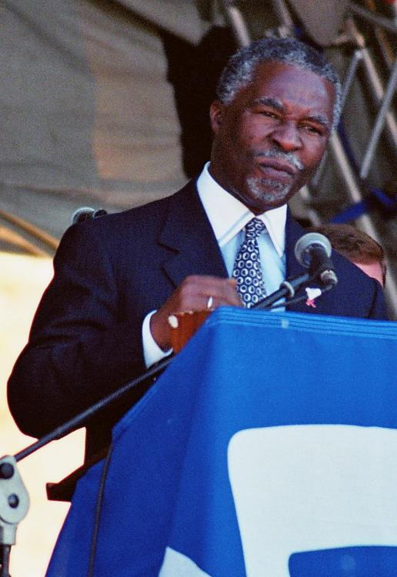
In the latter part of his presidency, Mandela increasingly relied on his Deputy President, Thabo Mbeki (pictured)

Slide 27
Withdrawing from politics
Inkatha remained part of the coalition, and when both Mandela and Mbeki were out of the country in September 1998, Buthelezi was appointed "Acting President", marking an improvement in his relationship with Mandela.
Mandela stepped down as ANC President at the party's December 1997 conference.
Although opinion polls in South Africa showed wavering support for both the ANC and the government, Mandela himself remained highly popular, with 80% of South Africans polled in 1999 expressing satisfaction with his performance as president.

Slide 28
Continued activism and philanthropy: 1999–2004
In 2002, Mandela inaugurated the Nelson Mandela Annual Lecture, and in 2003 the Mandela Rhodes Foundation was created at Rhodes House, University of Oxford, to provide postgraduate scholarships to African students.
These projects were followed by the Nelson Mandela Centre of Memory and the 46664 campaign against HIV/AIDS.
Publicly, Mandela became more vocal in criticising Western powers.

Slide 29
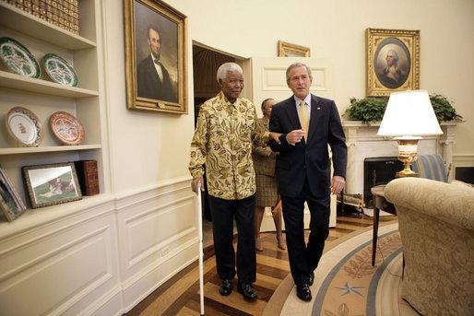
Nelson Mandela and President George W. Bush in the Oval Office, May 2005

Slide 30
"Retiring from retirement": 2004–2013
Mandela was more at ease with Mbeki's successor, Zuma, although the Nelson Mandela Foundation was upset when his grandson, Mandla Mandela, flew him out to the Eastern Cape to attend a pro-Zuma rally in the midst of a storm in 2009.
In mid-2013, as Mandela was hospitalised for a lung infection in Pretoria, his descendants were involved in an intra-family legal dispute relating to the burial place of Mandela's children, and ultimately Mandela himself.

Slide 31
Illness and death: 2011–2013
In February 2011, Mandela was briefly hospitalised with a respiratory infection, attracting international attention, before being re-admitted for a lung infection and gallstone removal in December 2012.
In September 2013, Mandela was discharged from hospital, although his condition remained unstable.

Slide 32
Political ideology
Mandela identified as both an African nationalist, an ideological position he held since joining the ANC, and as a socialist.
The historian Sabelo J. Ndlovu-Gatsheni described Mandela as a "liberal African nationalist–decolonial humanist", while political analyst Raymond Suttner cautioned against labelling Mandela a liberal and stated that Mandela displayed a "hybrid socio-political make-up".

Slide 33
Democracy
Although he presented himself in an autocratic manner in several speeches, Mandela was a devout believer in democracy and abided by majority decisions even when deeply disagreeing with them.
Suttner argued that there were "two modes of leadership" that Mandela adopted.
According to Lodge, Mandela's political thought reflected tensions between his support for liberal democracy and pre-colonial African forms of consensus decision making.

Slide 34
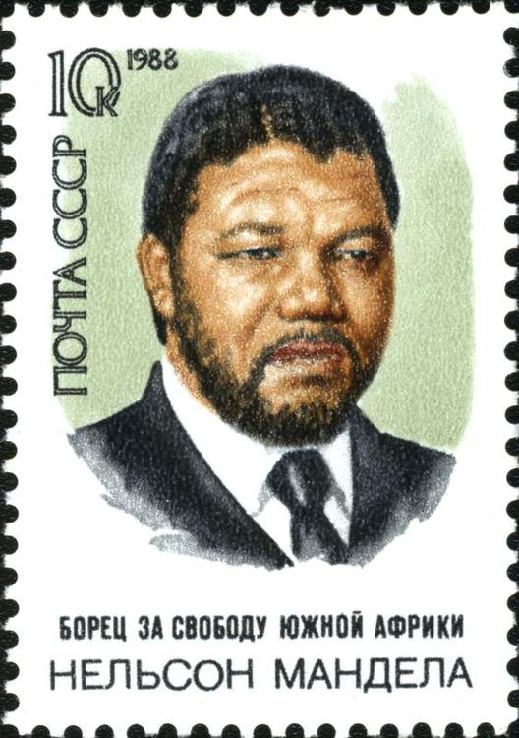
1988 Soviet commemorative stamp, captioned "The fighter for freedom of South Africa Nelson Mandela" in Russian

Slide 35
Socialism and Marxism
Mandela was influenced by Marxism, and during the revolution he advocated scientific socialism.
According to the sociologist Craig Soudien, "sympathetic as Mandela was to socialism, a communist he was not."
Conversely, the biographer David Jones Smith stated that Mandela "embraced communism and communists" in the late 1950s and early 1960s, while the historian Stephen Ellis commented that Mandela had assimilated much of the Marxist–Leninist ideology by 1960.

Slide 36
Personality and personal life
Mandela was a private person who often concealed his emotions and confided in very few people.
According to Sampson, Mandela never had "a strong religious faith" however, while Boehmer stated that Mandela's religious belief was "never robust".
Mandela was very self-conscious about being a man and regularly made references to manhood.

Slide 37
Reception and legacy
In 1986, Mandela's biographer characterised him as "the embodiment of the struggle for liberation" in South Africa.
Sampson commented that even during his life, this myth had become "so powerful that it blurs the realities", converting Mandela into "a secular saint".
Mandela's iconic status has been blamed for concealing the complexities of his life.

Slide 38
Orders, decorations, monuments, and honours
In 2004, Johannesburg granted Mandela the Freedom of the City, and in 2008 a Mandela statue was unveiled at the spot where Mandela was released from prison.
In November 2009, the United Nations General Assembly proclaimed Mandela's birthday, 18 July, as "Mandela Day", marking his contribution to the anti-apartheid struggle.

Slide 39
Biographies and popular media
The second was Anthony Sampson's Mandela, published in 1999.
Other biographies included Martin Meredith's Mandela, first published in 1997, and Tom Lodge's Mandela, brought out in 2006.
In the 1980s he was the subject of several songs, such as The Specials' "Free Nelson Mandela", Hugh Masekela's "Bring Him Back Home (Nelson Mandela)", and Johnny Clegg's "Asimbonanga (Mandela)", which helped to bring awareness of his imprisonment to an international audience.

Slide 40
See also
Mandela effect

Slide 41
External links
Nelson Mandela Centre of Memory
Nelson Mandela Children's Fund
Nelson Mandela Foundation
Nelson Mandela Museum
Nelson Mandela Day
Nelson Mandela at Curlie
Nelson Mandela on IMDb

